Slide 1
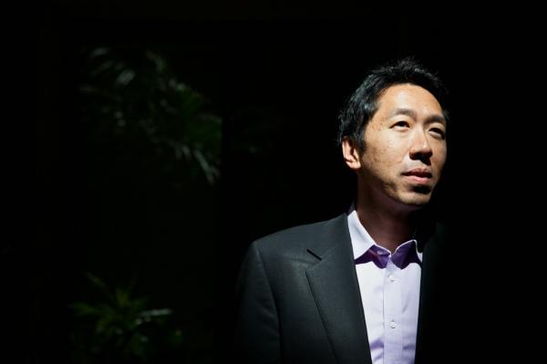
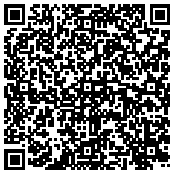
Andrew Ng moves to the IDL of Baidu
@ May 16th 2014
http://www.mercurynews.com/business/ci_25776547/baidu-hires-andrew-ng-artificial-intelligence-valley-labs

Slide 2
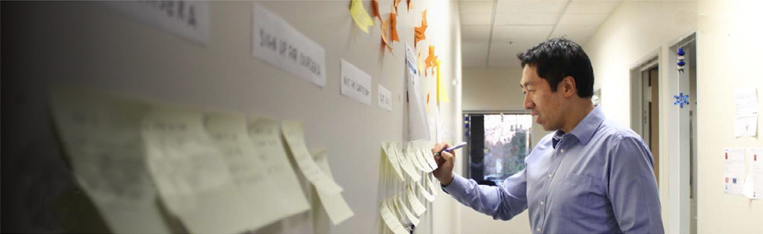
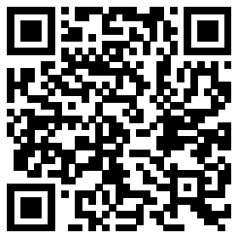
Andrew Y. Ng is an associate professor in the Department of Computer Science and the Department of Electrical Engineering by courtesy at Stanford University, and he works as the Director of the Stanford Artificial Intelligence Lab.
Born: 1976, United Kingdom
Nationality: American
Education: University of California, Berkeley (1993), Carnegie Mellon University

Slide 3
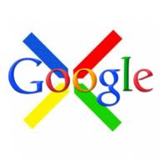
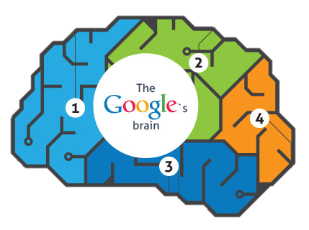
Google Brain is an unofficial name for a deep learning research project at Google.
Andrew Ng became interested in using deep learning techniques to crack the problem of artificial intelligence since around 2006, started Google's Deep Learning project (which would later acquire the name Google Brain) in 2011 as one of the Google X projects.

Slide 4
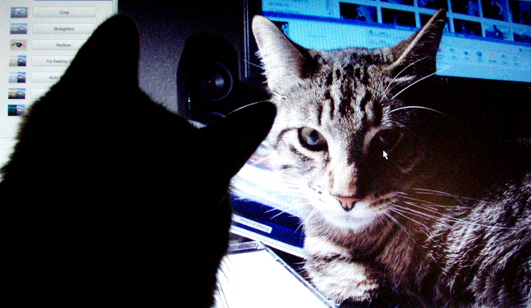
Google’s Artificial Brain Learns
to Find Cat Videos
In June 2012, the New York Times reported that a cluster of 16,000 computers dedicated to mimicking some aspects of human brain activity had successfully trained itself to recognize a cat based on 10 million digital images taken from YouTube videos
A massive neural network with 1 billion parameters learned from unlabeled YouTube videos.
http://www.wired.com/2013/06/andrew_ng/

Slide 5
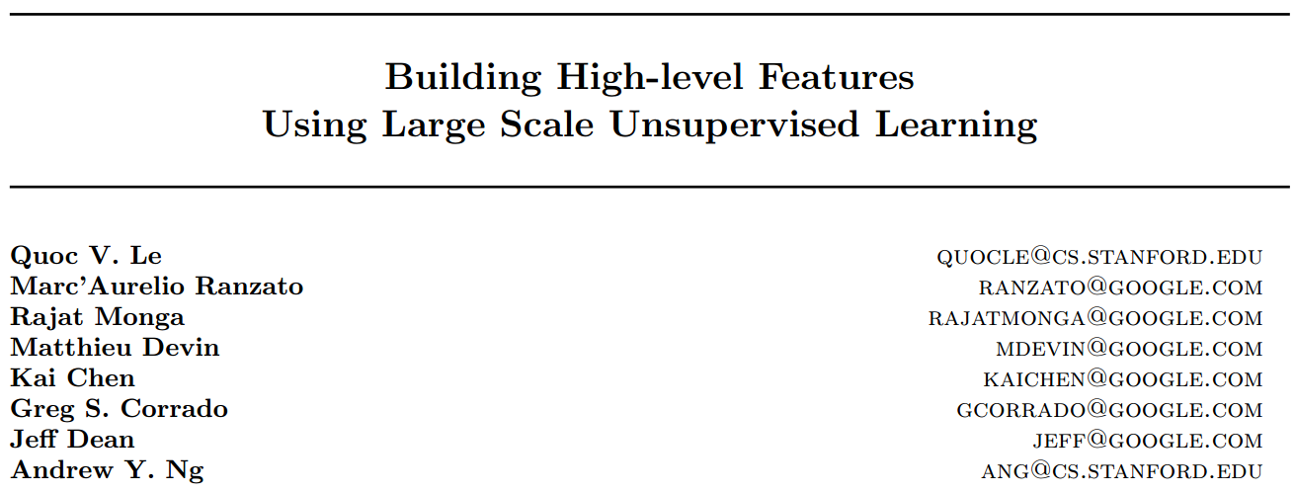
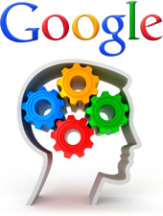
We never told it during the training ‘This is a cat,’
The idea is that instead of having teams of researchers trying to find out how to find edges, you instead throw a ton of data at the algorithm and you let the data speak and have the software automatically learn from the data,”
-- Andrew Ng

Slide 6
Most of the previous algorithms have only succeeded in learning low-level features such as “edge" or “blob" detectors.
The idea is that instead of having teams of researchers trying to find out how to find edges, you instead throw a ton of data at the algorithm and you let the data speak and have the software automatically learn from the data,”
-- Andrew Ng

Slide 7

Picking up on the most commonly occurring images featured on YouTube, the system achieved 81.7 percent accuracy in detecting human faces, 76.7 percent accuracy when identifying human body parts and 74.8 percent accuracy when identifying cats.

Slide 8
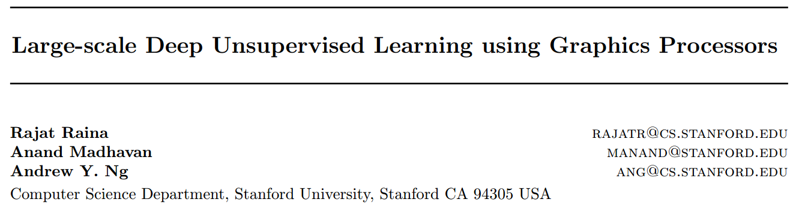
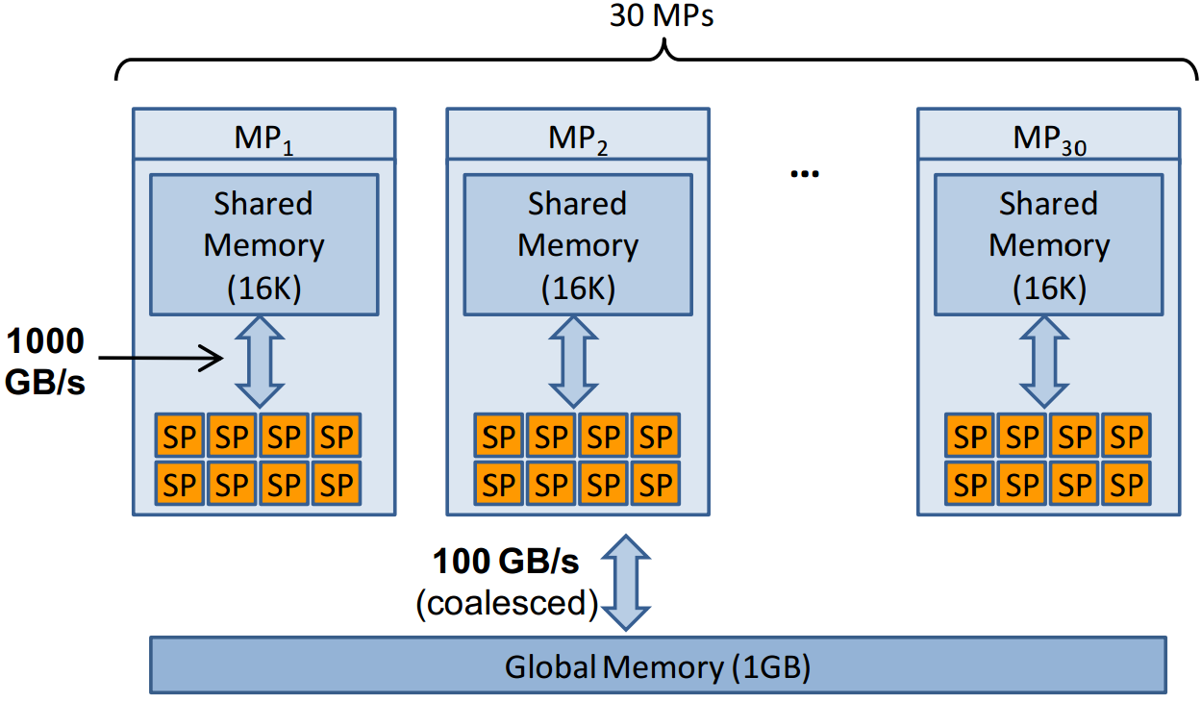
Raina, Rajat, Anand Madhavan, and Andrew Y. Ng. "Large-scale deep unsupervised learning using graphics processors." In ICML, vol. 9, pp. 873-880. 2009.

Slide 9
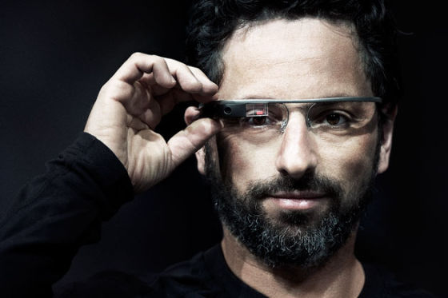


Slide 10

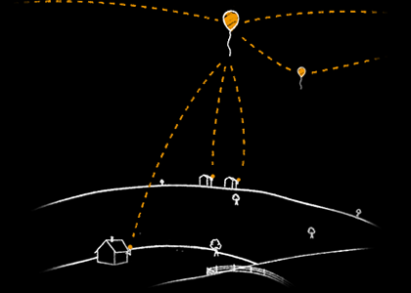
Project Loon balloons float in the stratosphere, twice as high as airplanes and the weather. In the stratosphere, there are many layers of wind, and each layer of wind varies in direction and speed. Loon balloons go where they’re needed by rising or descending into a layer of wind blowing in the desired direction of travel. People can connect to the balloon network using a special Internet antenna attached to their building. The signal bounces from this antenna up to the balloon network, and then down to the global Internet on Earth.

Slide 11
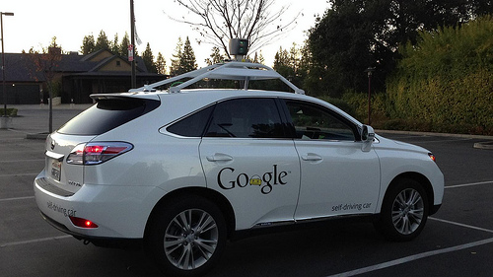

Slide 12
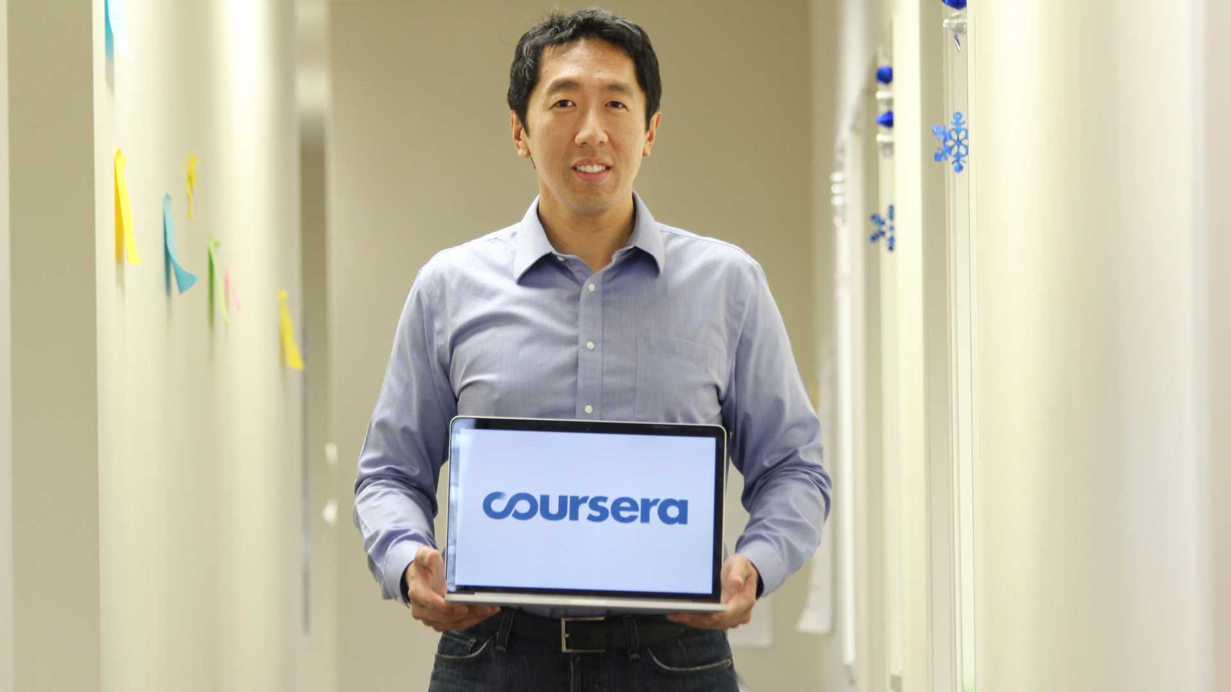
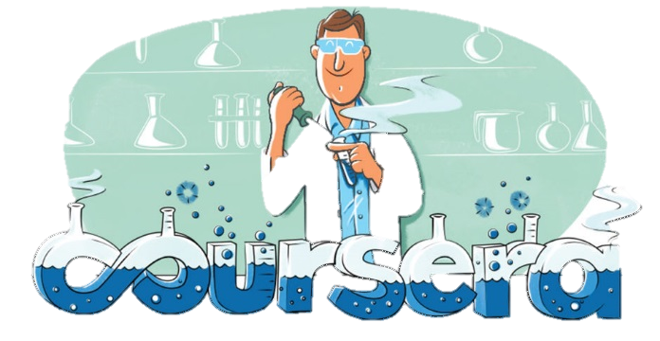
In 2011, I taught my first machine learning MOOC to 104,000 learners, which led to the founding of Coursera. I’m proud that Coursera has since grown this movement to 7.5 million learners, and that we now offer courses from more than 100 incredible institutions.
MOOC (Massive Open Online Courses)

Slide 13

Andrew Ng and Daphne Koller Coursera co-founders, 37 and 44
Andrew Ng was recently named (together with with Daphne Koller) to be one of the Time 100 list of the world’s most influential individuals. Since Ng taught his first MOOC in 2011, which enrolled 104,000 students, the MOOC movement has grown substantially, and today Coursera has over 3 million students.

Slide 14
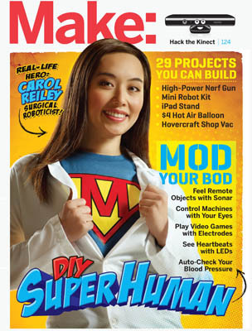

Carol reiley
A surgical roboticist at Johns Hopkins University and is involved in a new robot start-up

Slide 15
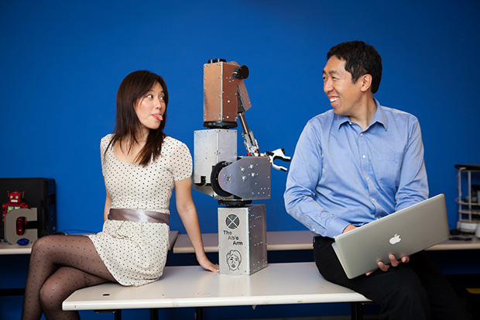
http://spectrum.ieee.org/automaton/robotics/humanoids/engaging-with-robots
Robots Bring Couple Together, Engagement Ensues

Slide 16
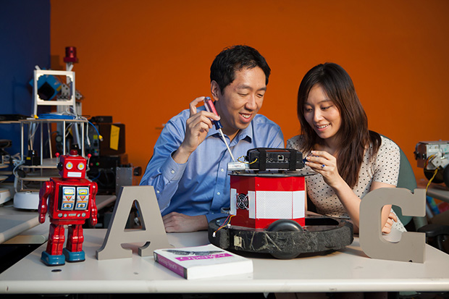

Slide 17
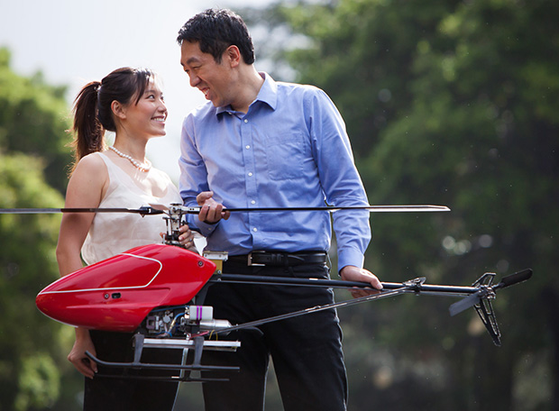

Slide 18
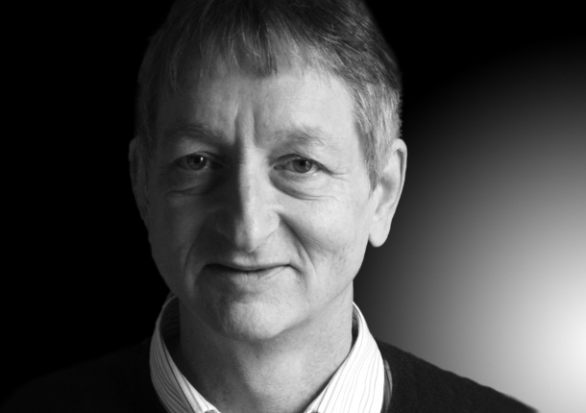
In March 2013, Google hired Geoffrey Hinton, a leading researcher in the deep learning field, and acquired the company DNNResearch Inc. headed by Hinton. Hinton said that he would be dividing his future time between his university research and his work at Google.

Slide 19

Neural Networks for Machine Learning by Geoffrey Hinton

Slide 20

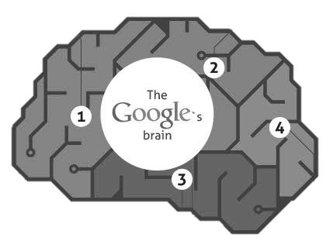

Institute of Deep Learning
http://idl.baidu.com/index.html

Slide 21


Slide 22
